Slide 1



Slide 2
Database Management Systems Online Doctor Visit Appointment
By
Mogilicharla Nishanth(2110030288)
Gurram Sri Charan(2110030285)
Gangidi Chaithanya Reddy(2110030309)
Patlolla Maheshwari Reddy(2110030204)
Under the guidance of
-DR.SUMIT HAZRA

Slide 3
Problem statement and domain
Managing many different appointment types.
It takes more time to go and take consultancy by a doctor.
Gathering all documentation and authorizations necessary before an appointment.
Adjusting schedules for doctor appointment based on provider preferences for appointment types.

Slide 4
Existing solutions/ Naïve solutions
These is one solution which already exist.
It is by offline registration of appointment for doctor through the reception office in hospital.
And some doctor consultancy was done offline in hospital.
After completing of appointment medicines were taken from medical stores.
There is also some online portals like Apollo24/7 for doctor consultancies.

Slide 5
Proposed Algorithm Design Technique
The main objective of our project online doctor visit appointment is to make in online mode.
Online registrations were done through online for appointment of a doctor.
And also for online doctor consultancy through video conference.
Medicines will be delivered to home.

Slide 6
Data Structures needed
A data structure is a specialized format for organizing, storing the data, processing and retrieving.
Tools required:
MYSQL
HTML
PYTHON
TerraEr

Slide 7
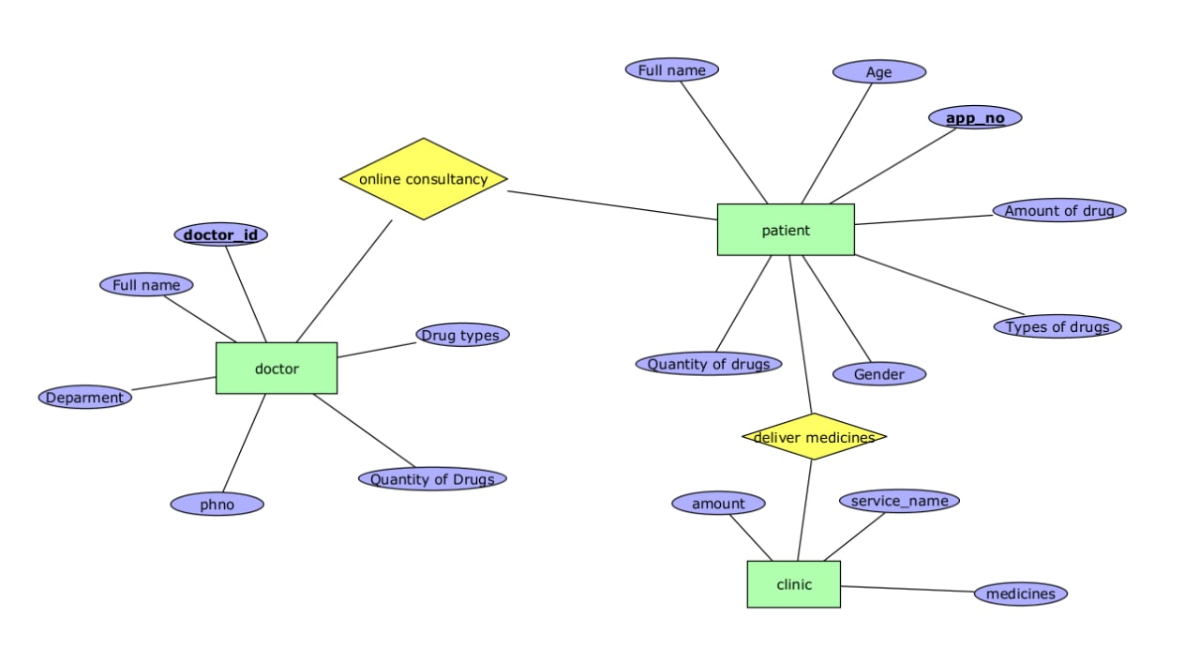
ER Diagram

Slide 8
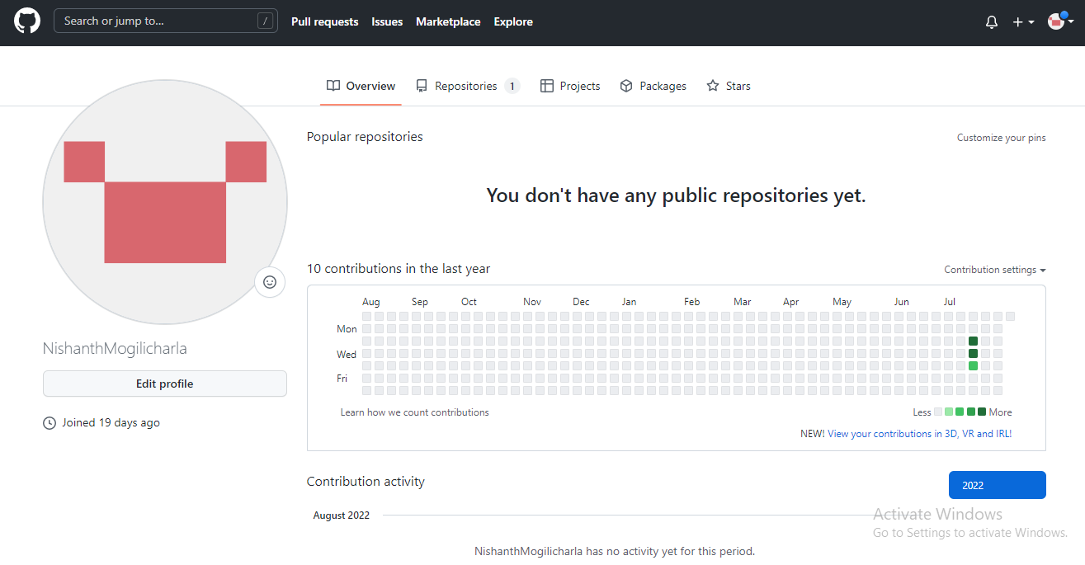
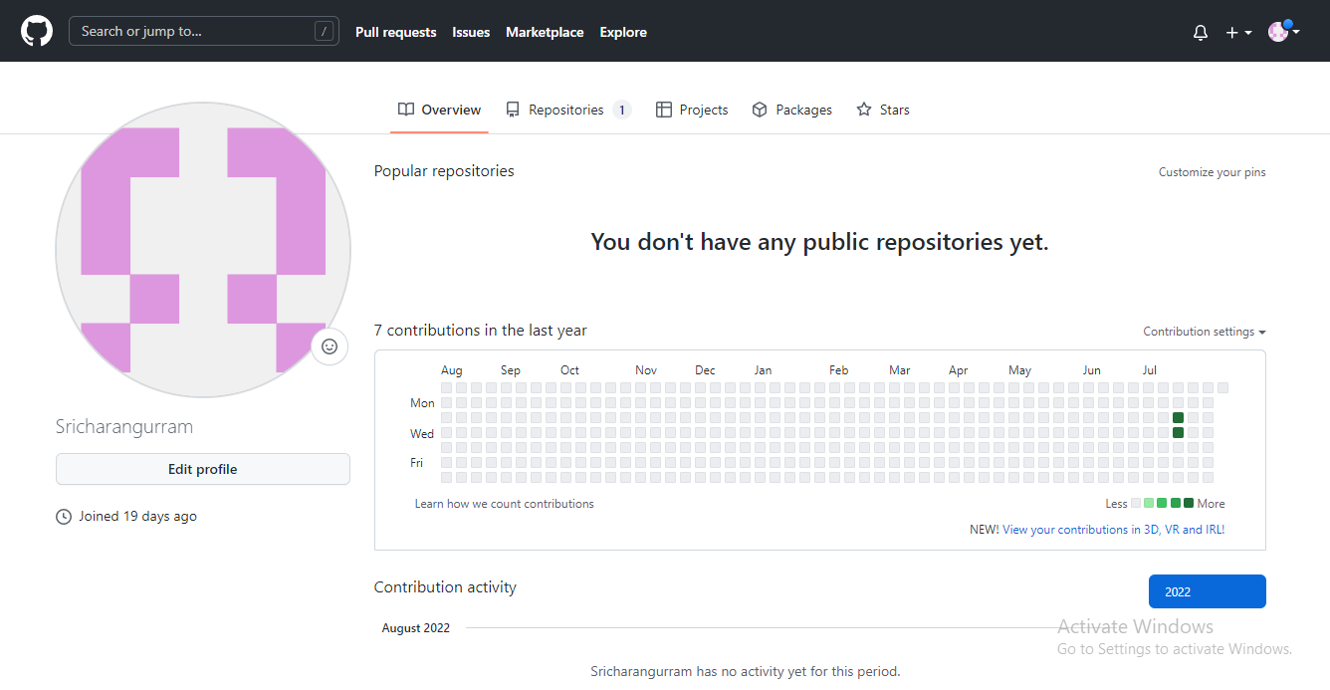
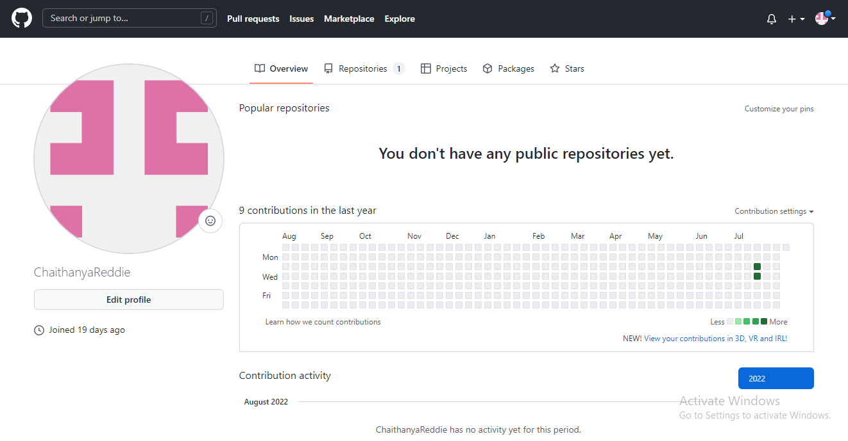
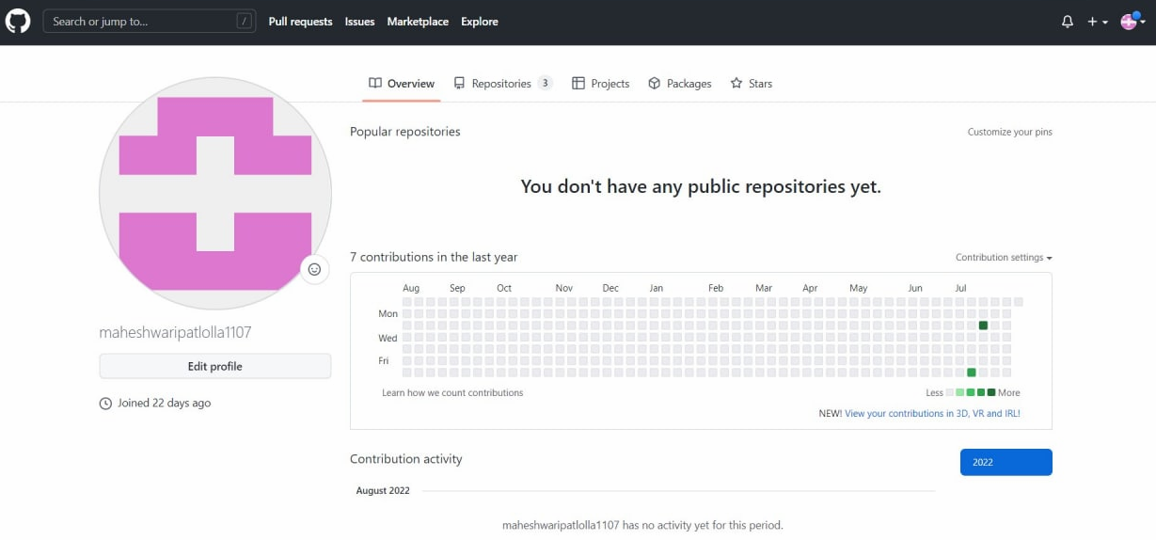
Github setup

Slide 9
Division of work among the group members
Web development: 2110030309,2110030288
Code development: 2110030309,2110030288,2110030285,2110030204
Case diagrams : 2110030204,2110030285
Data Collections: 2110030309,2110030288,2110030285,2110030204
Powerpoint Making: 2110030204,2110030288
Errorr Correcttions : 2110030309,211003028

Slide 10


